Slide 1
Working diagram and data sources
Nutrient diversity in the food system
Sold diversity
System diversity
Catch diversity
Consumption diversity
Nutrient diversity in household diets
Biomonitoring data
CFR-level
Catch and consumption monitoring data
Household-level
Nutrient database
Species-level

Slide 2
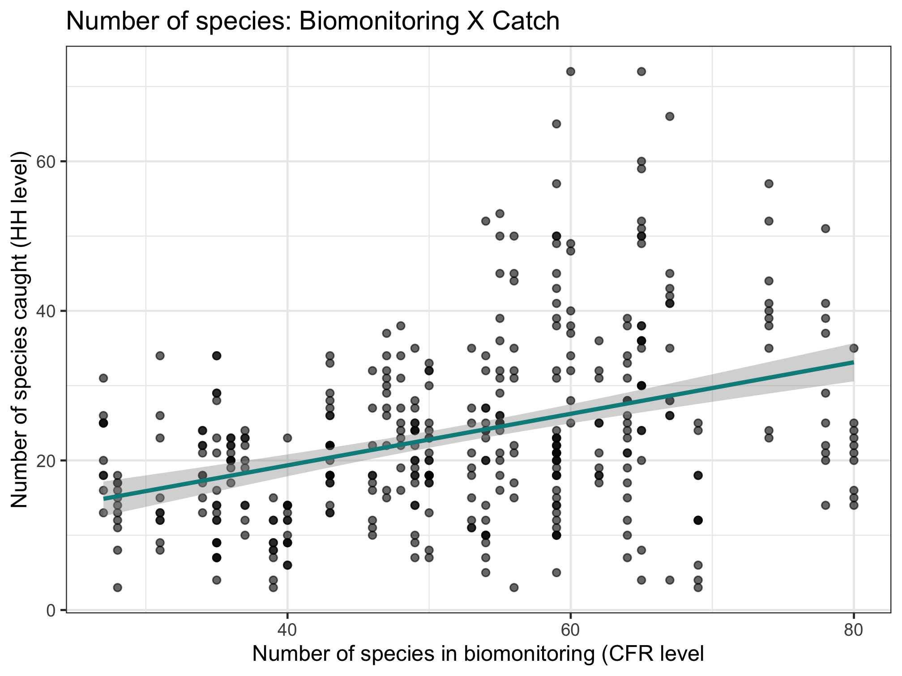
Nutrient diversity in the food system
Sold diversity
Slope = 0.384
System diversity
Catch diversity
Consumption diversity
Nutrient diversity in household diets

Slide 3
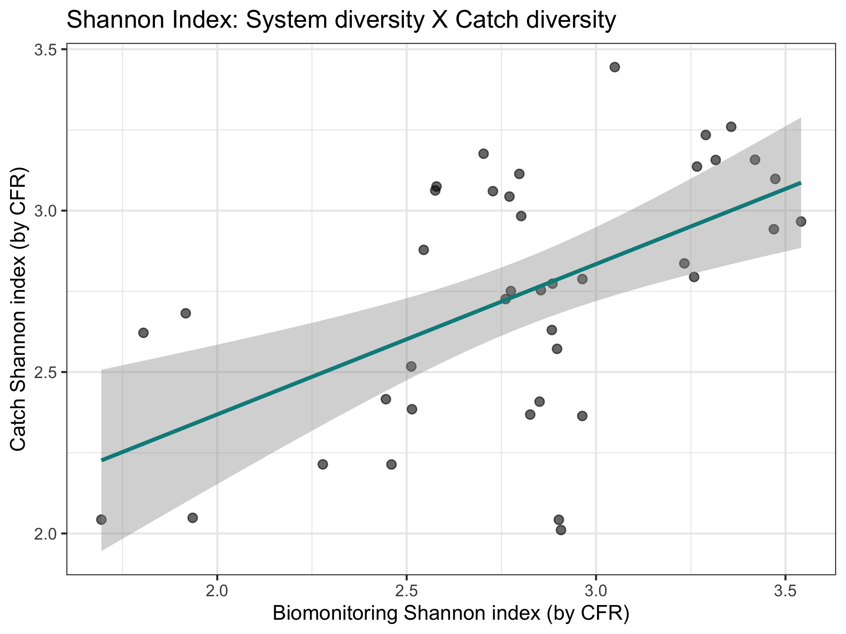
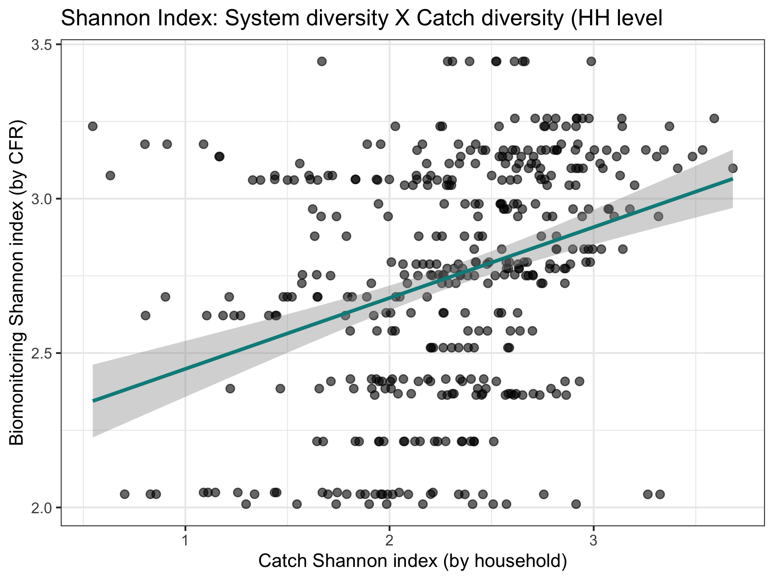
Nutrient diversity in the food system
Sold diversity
Slope = 0.486
System diversity
Catch diversity
Consumption diversity
Nutrient diversity in household diets
Slope = 0.376

Slide 4
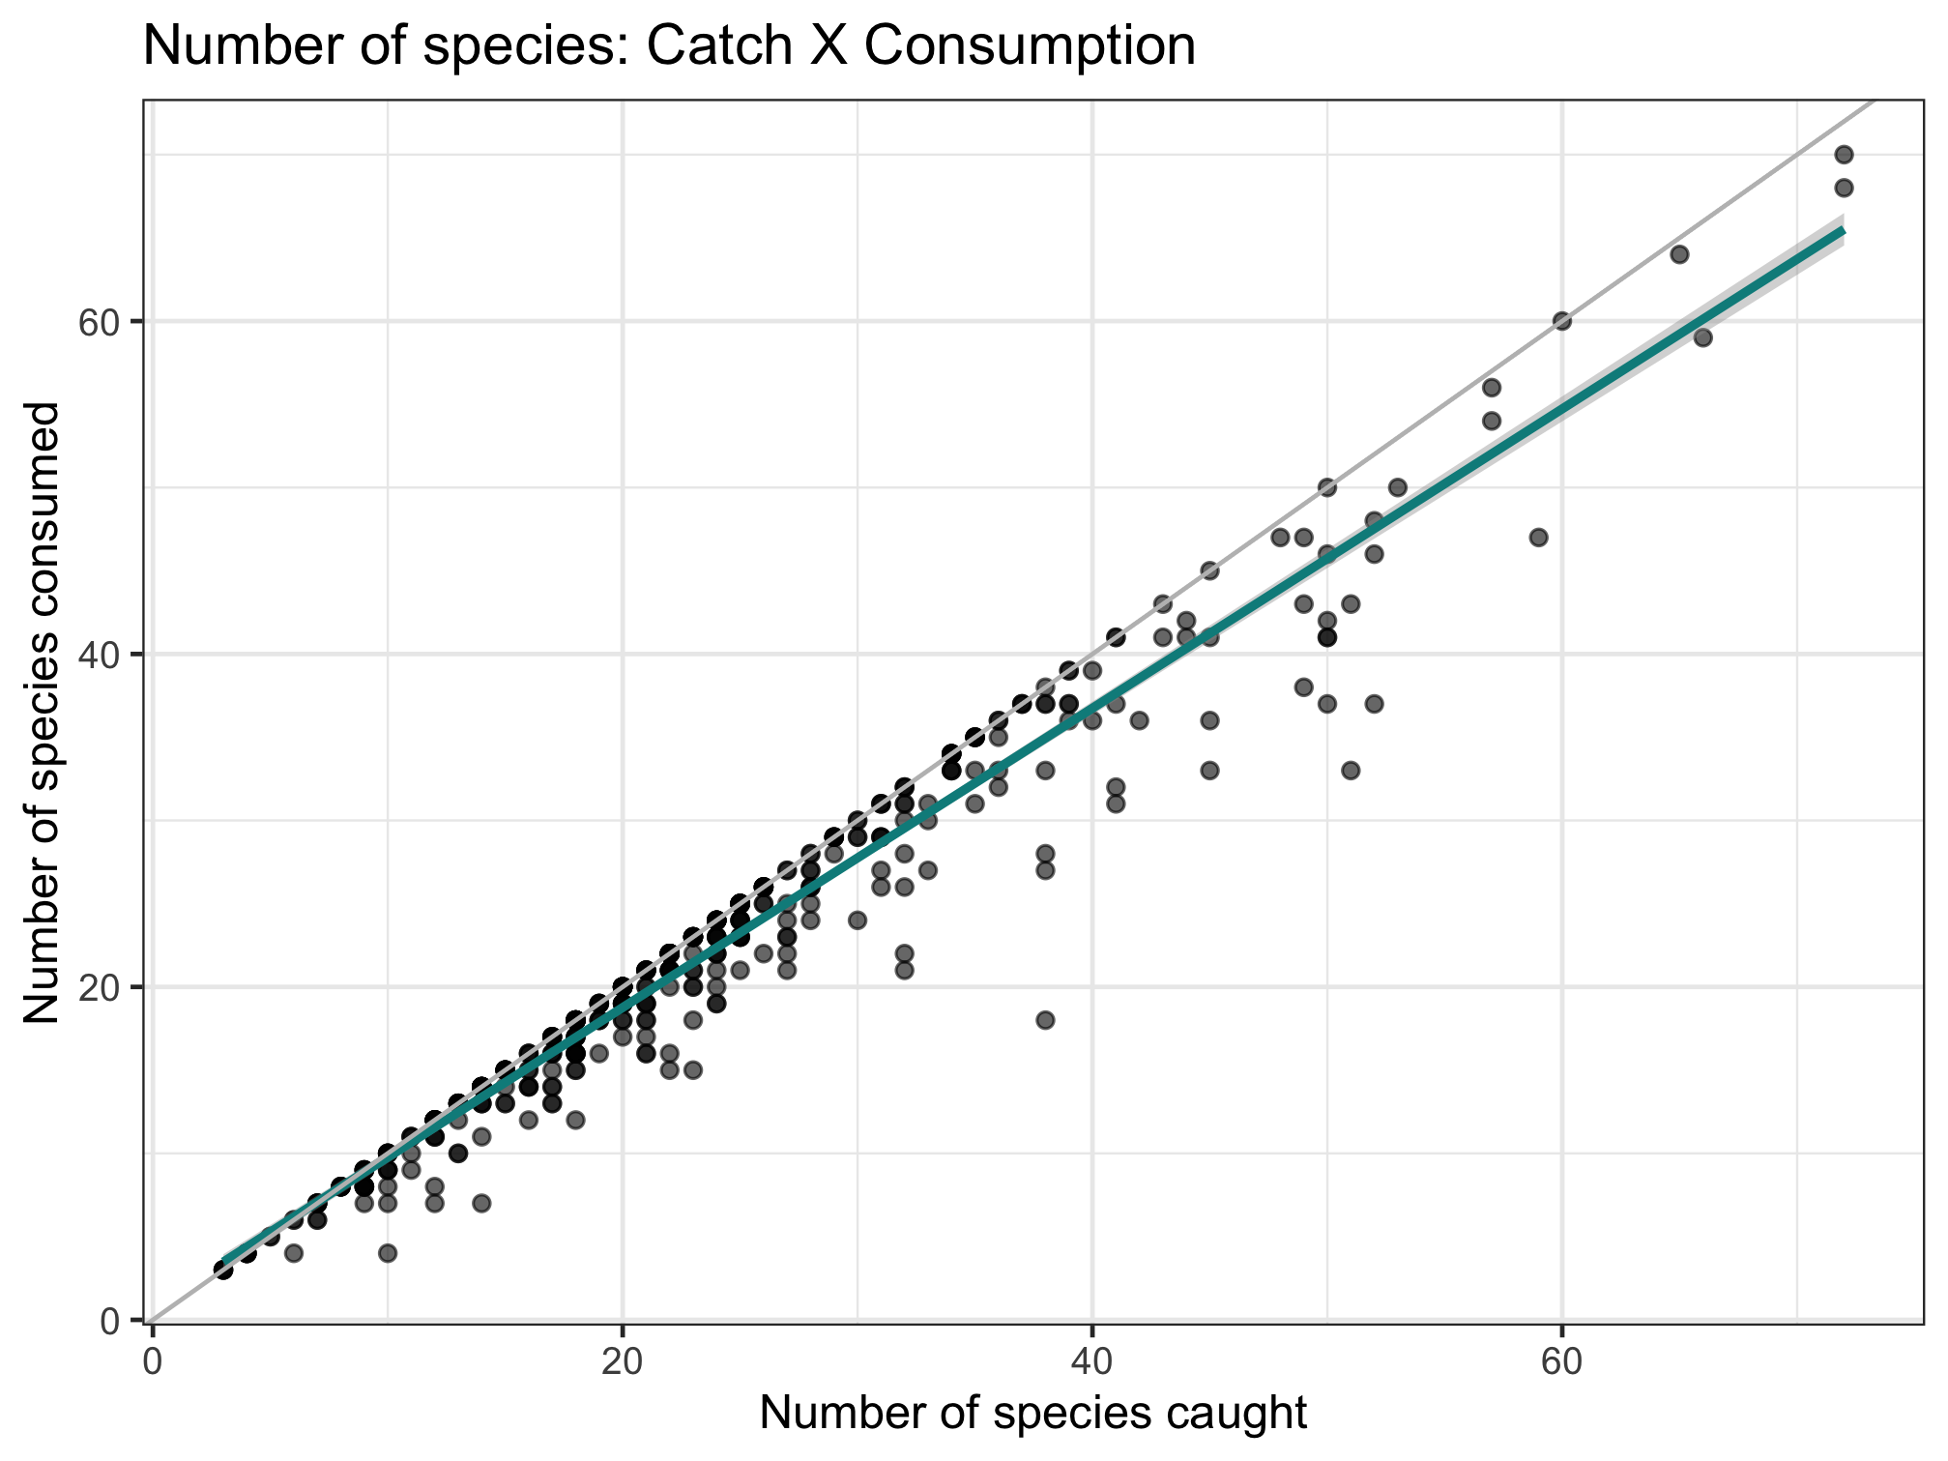
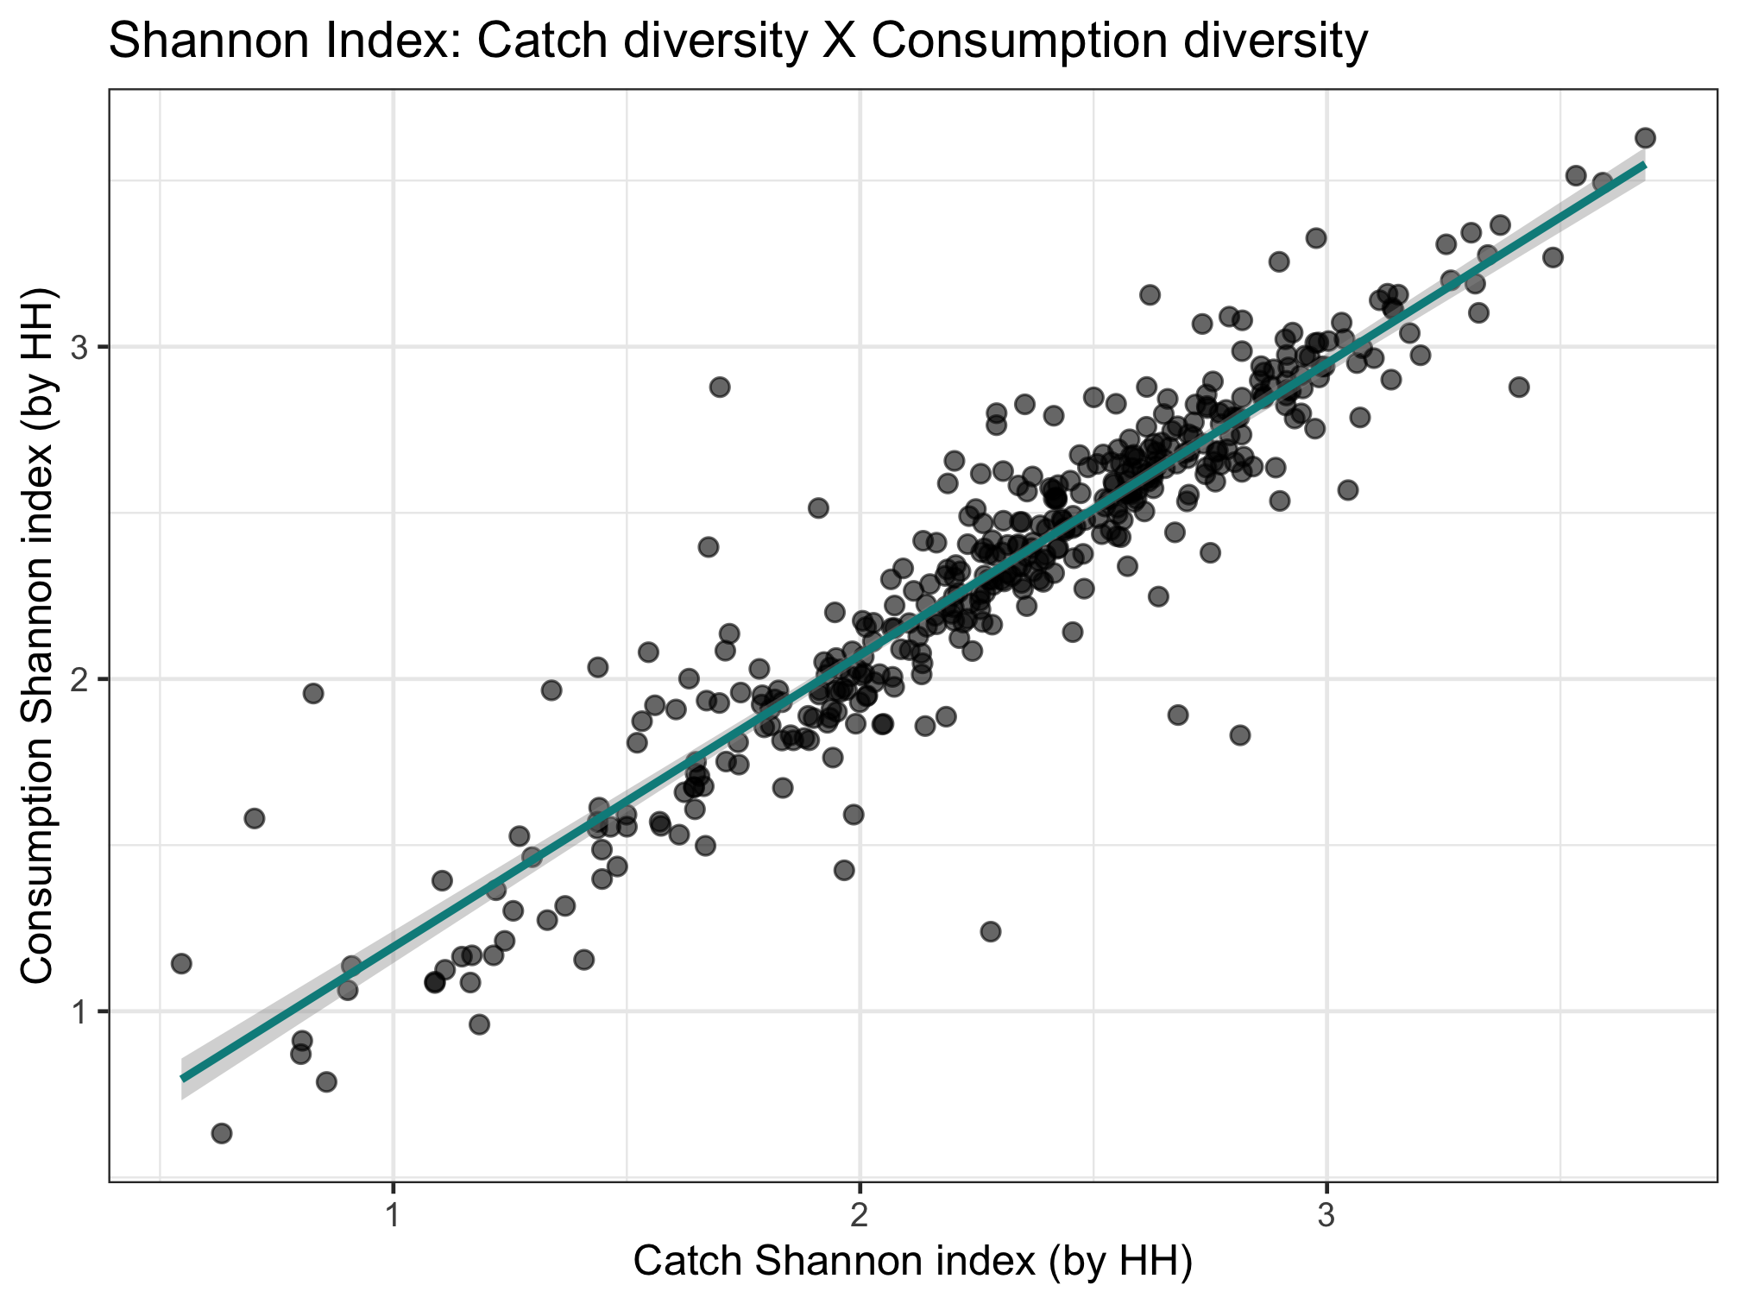
Nutrient diversity in the food system
Sold diversity
Slope = 0.979
System diversity
Catch diversity
Consumption diversity
Nutrient diversity in household diets
Slope = 0.924

Slide 5
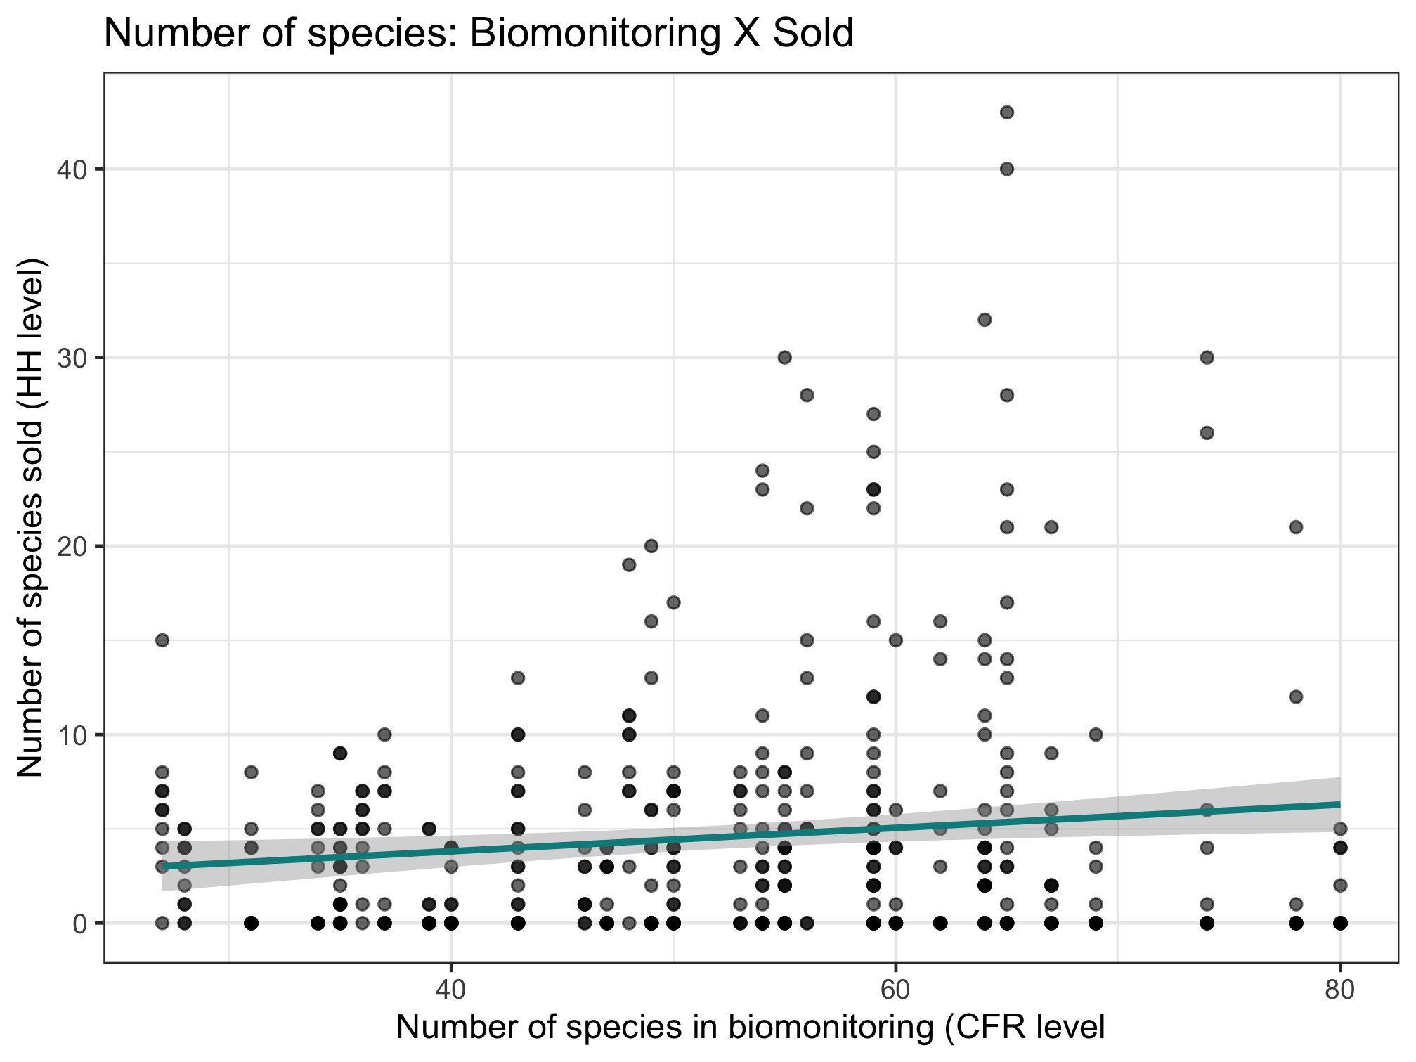
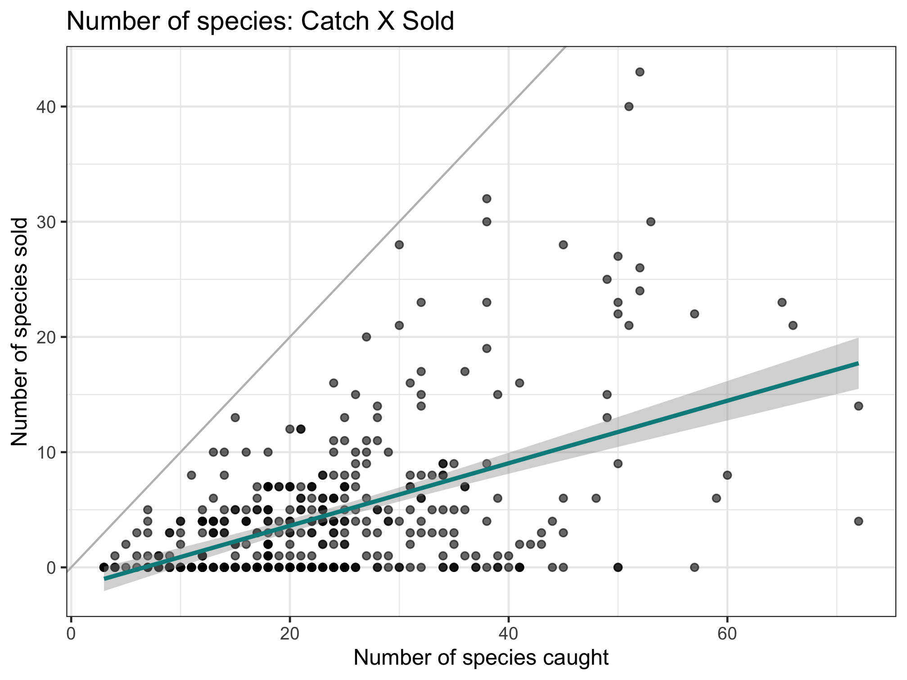
Nutrient diversity in the food system
Sold diversity
System diversity
Catch diversity
Consumption diversity
Nutrient diversity in household diets
Slope = 0.397

Slide 6
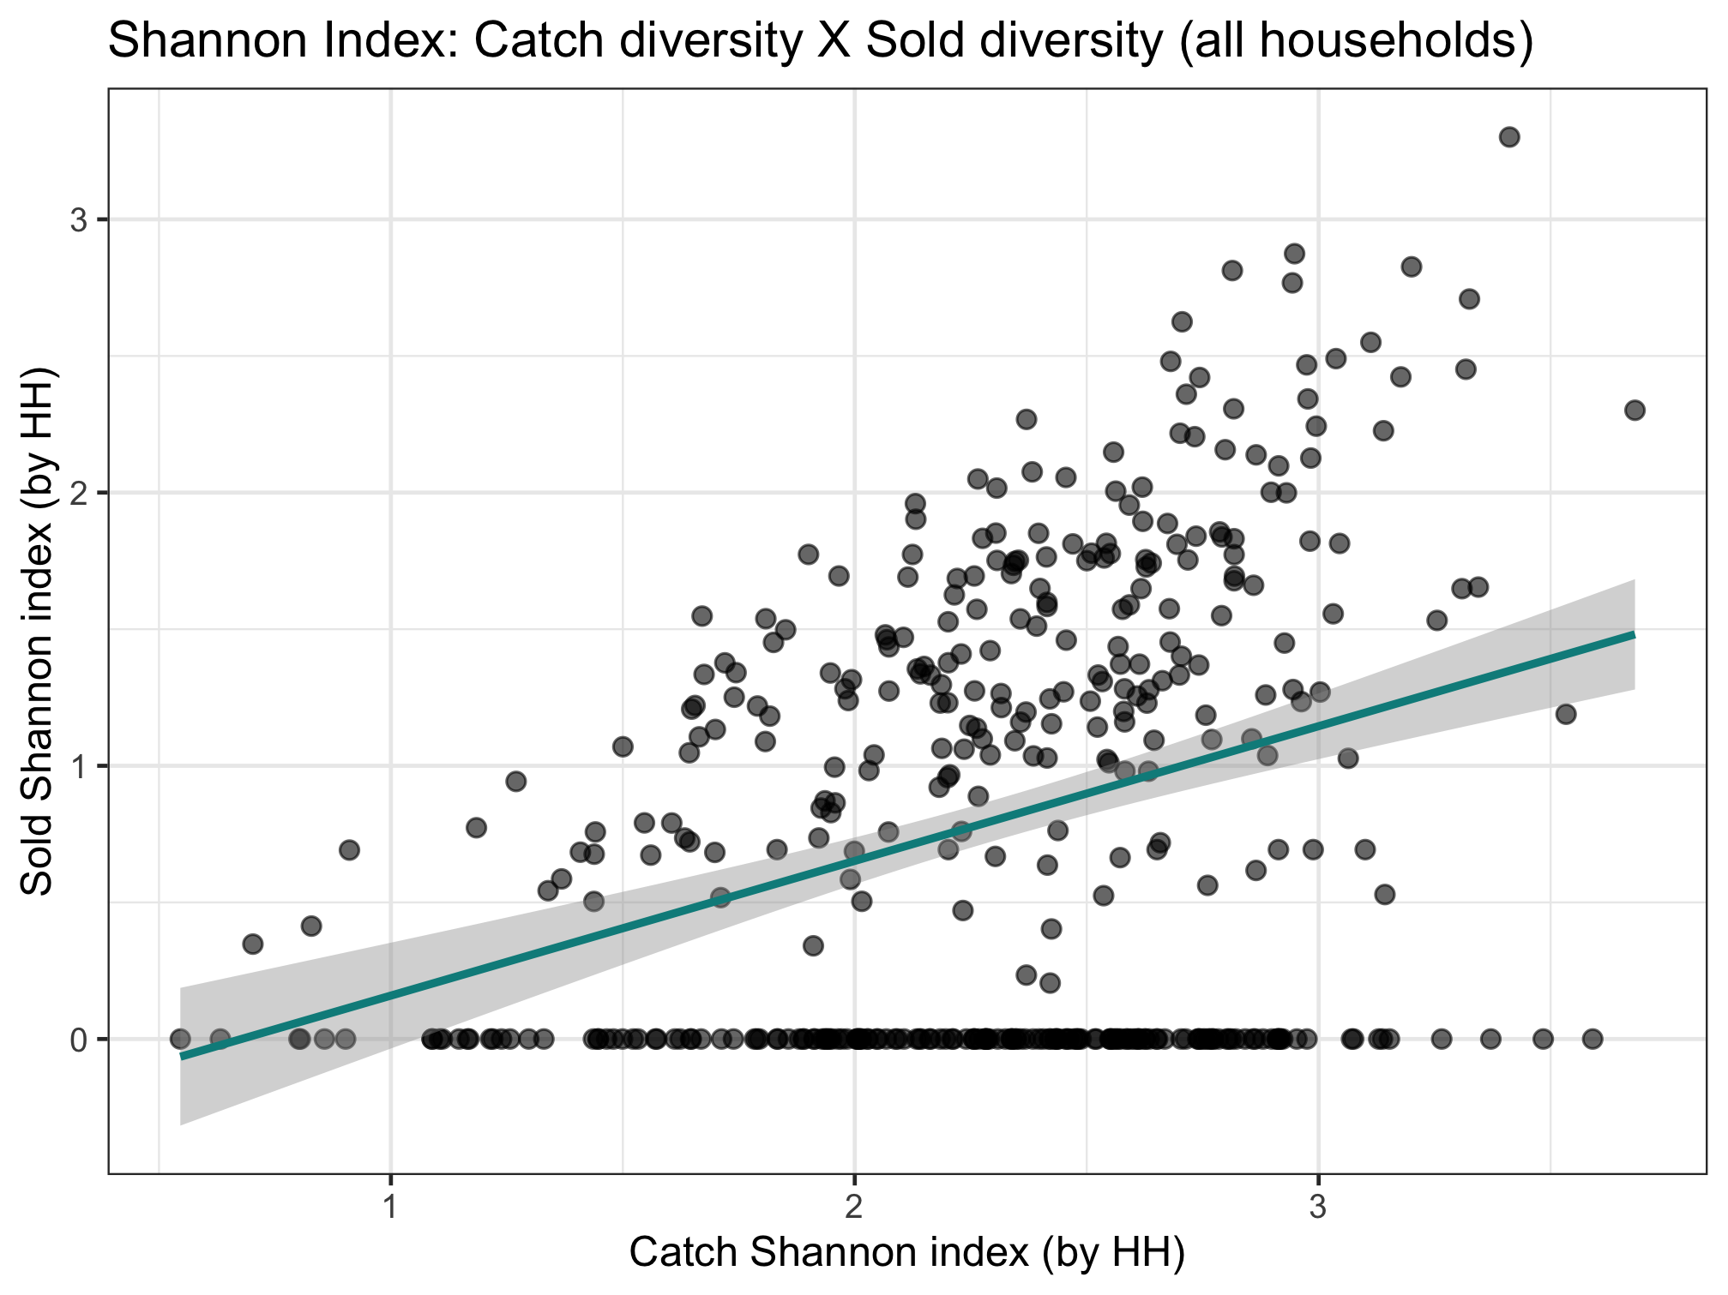
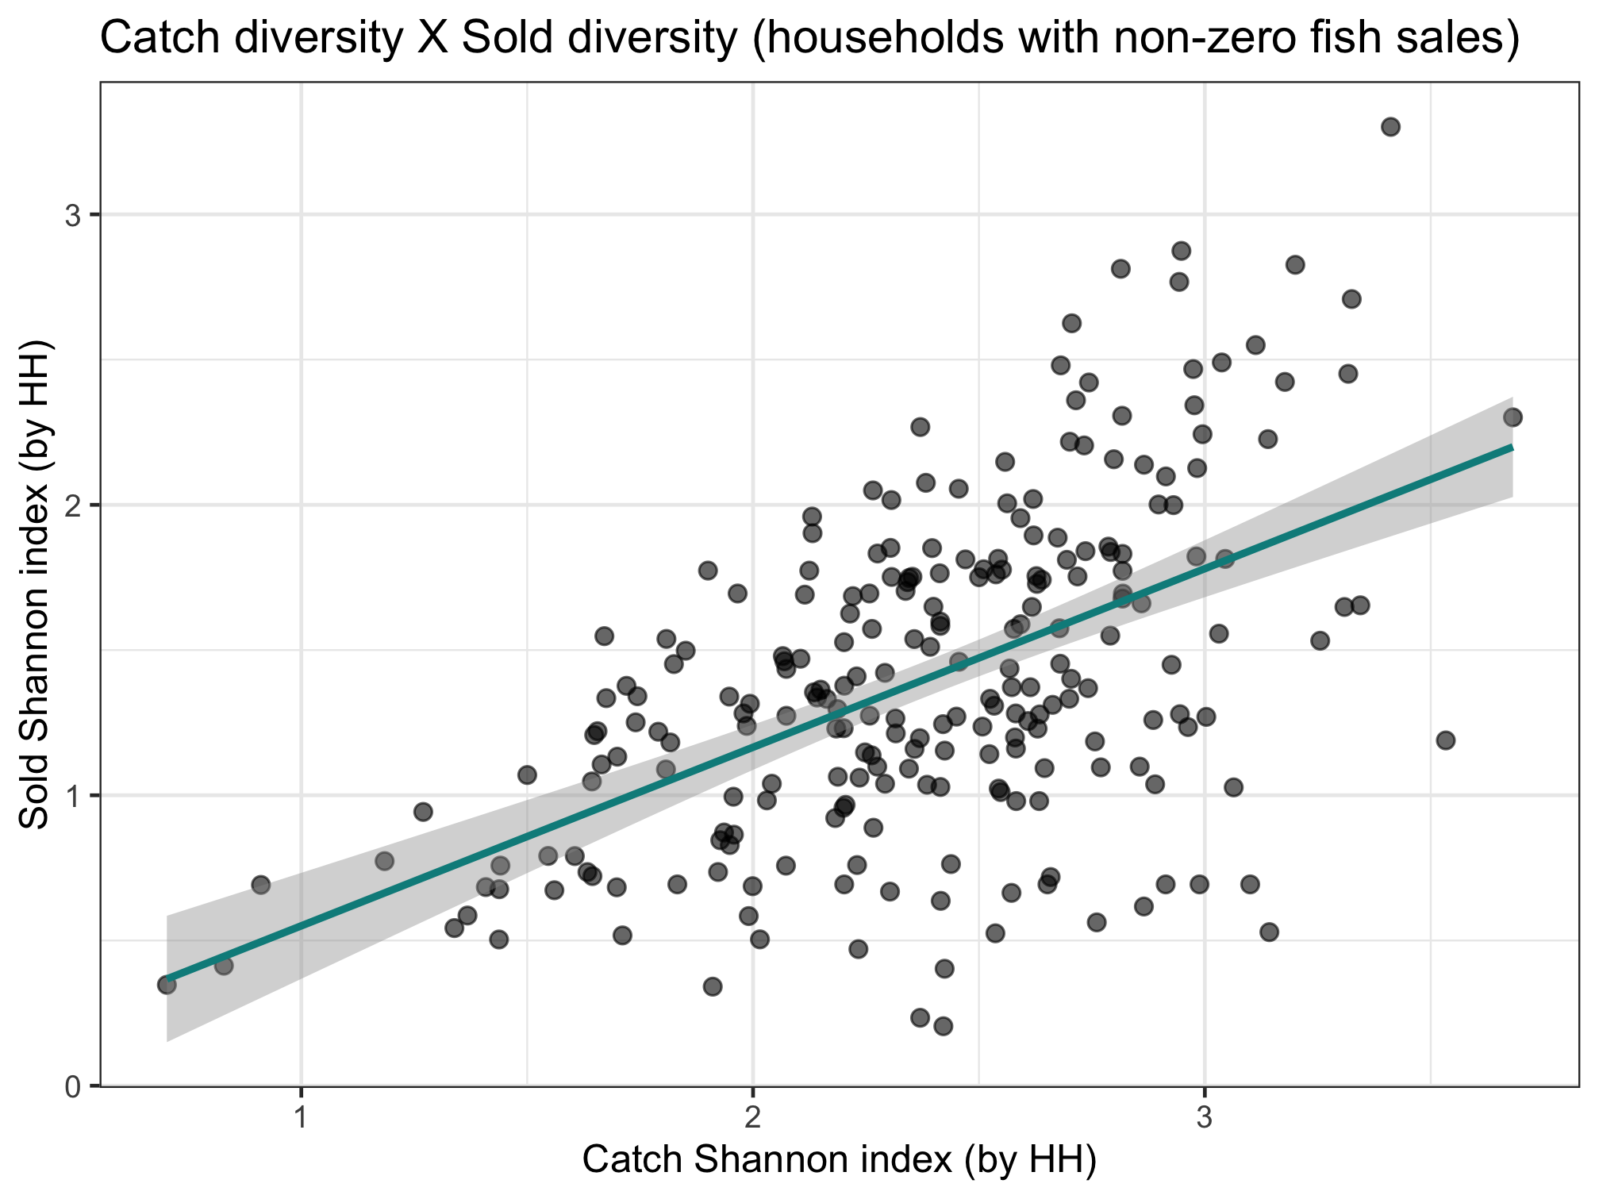
Nutrient diversity in the food system
Sold diversity
Slope = 0.287
System diversity
Catch diversity
Consumption diversity
Nutrient diversity in household diets
Slope = 0.493

Slide 7
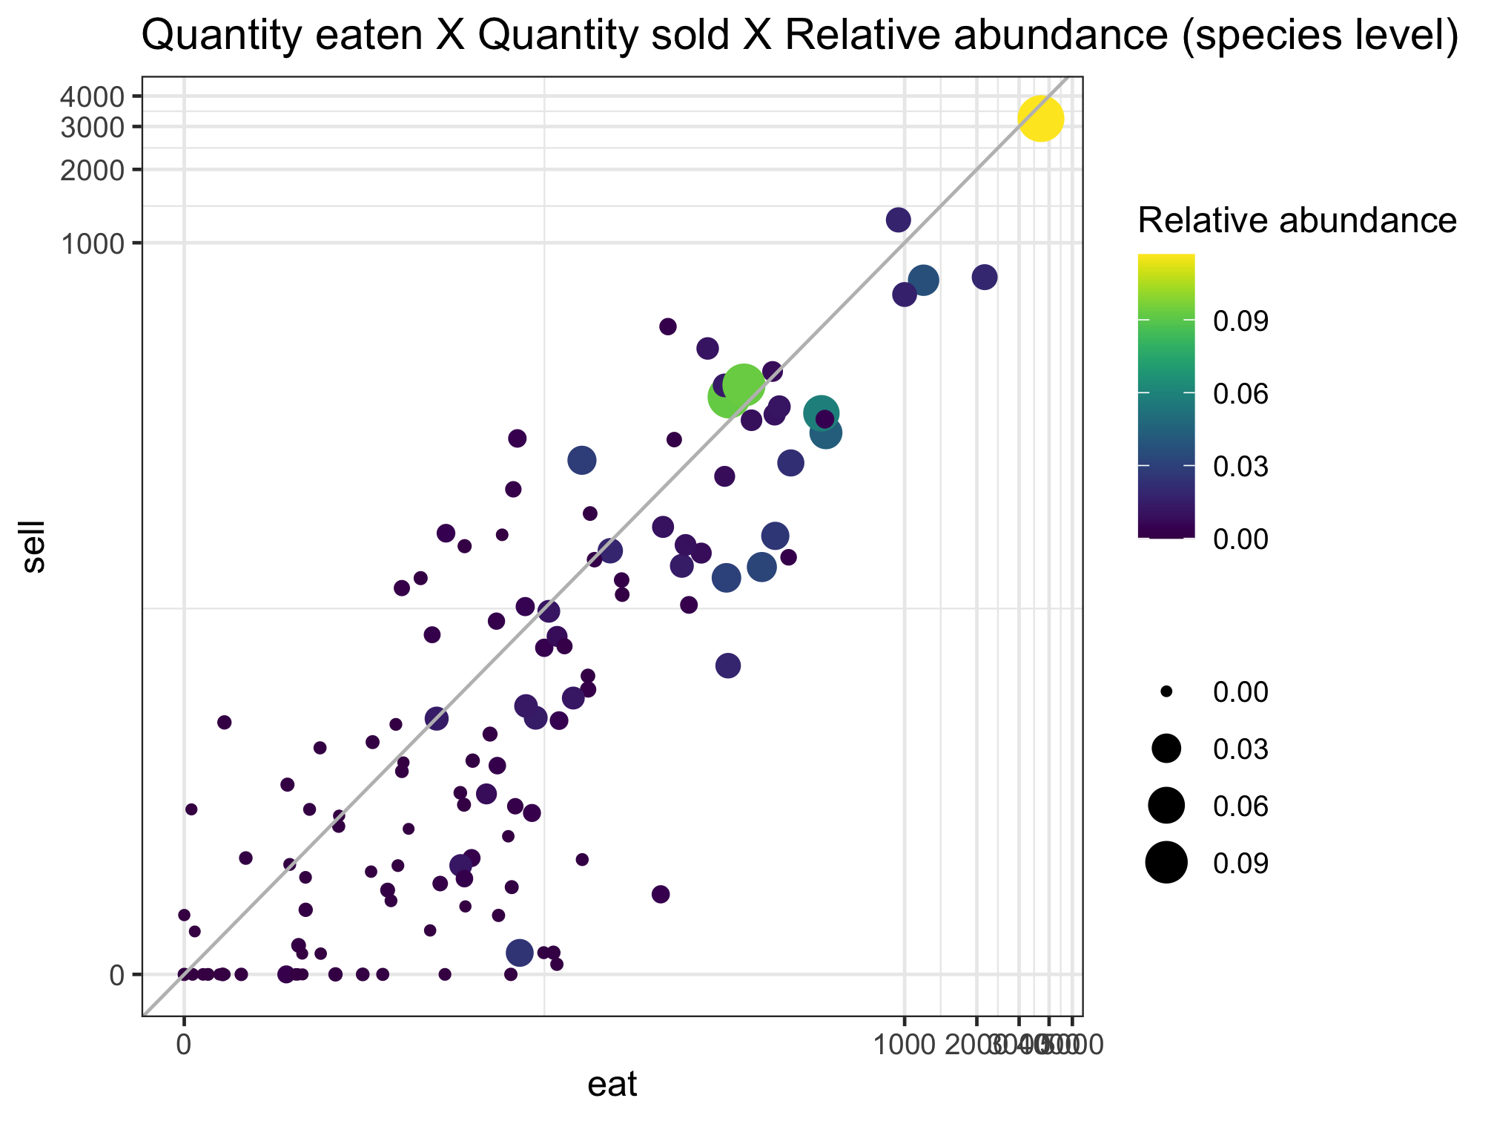
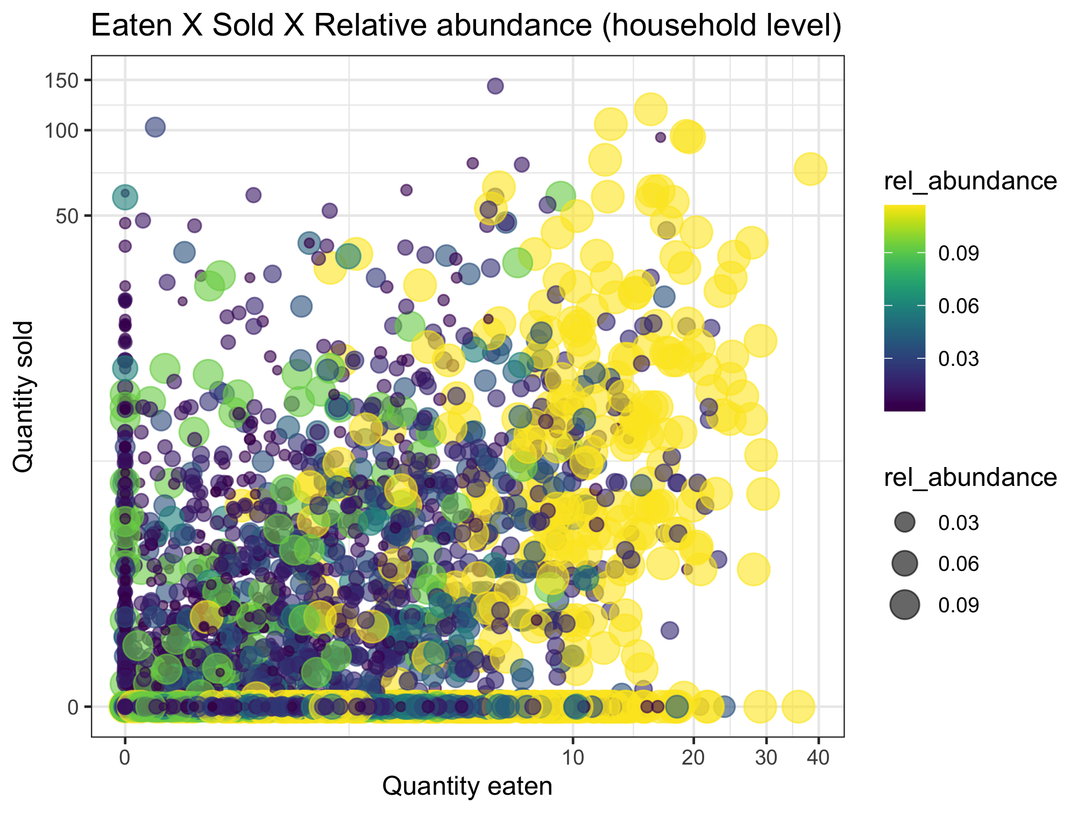
Nutrient diversity in the food system
Sold diversity
System diversity
Catch diversity
Consumption diversity
Nutrient diversity in household diets

Slide 8
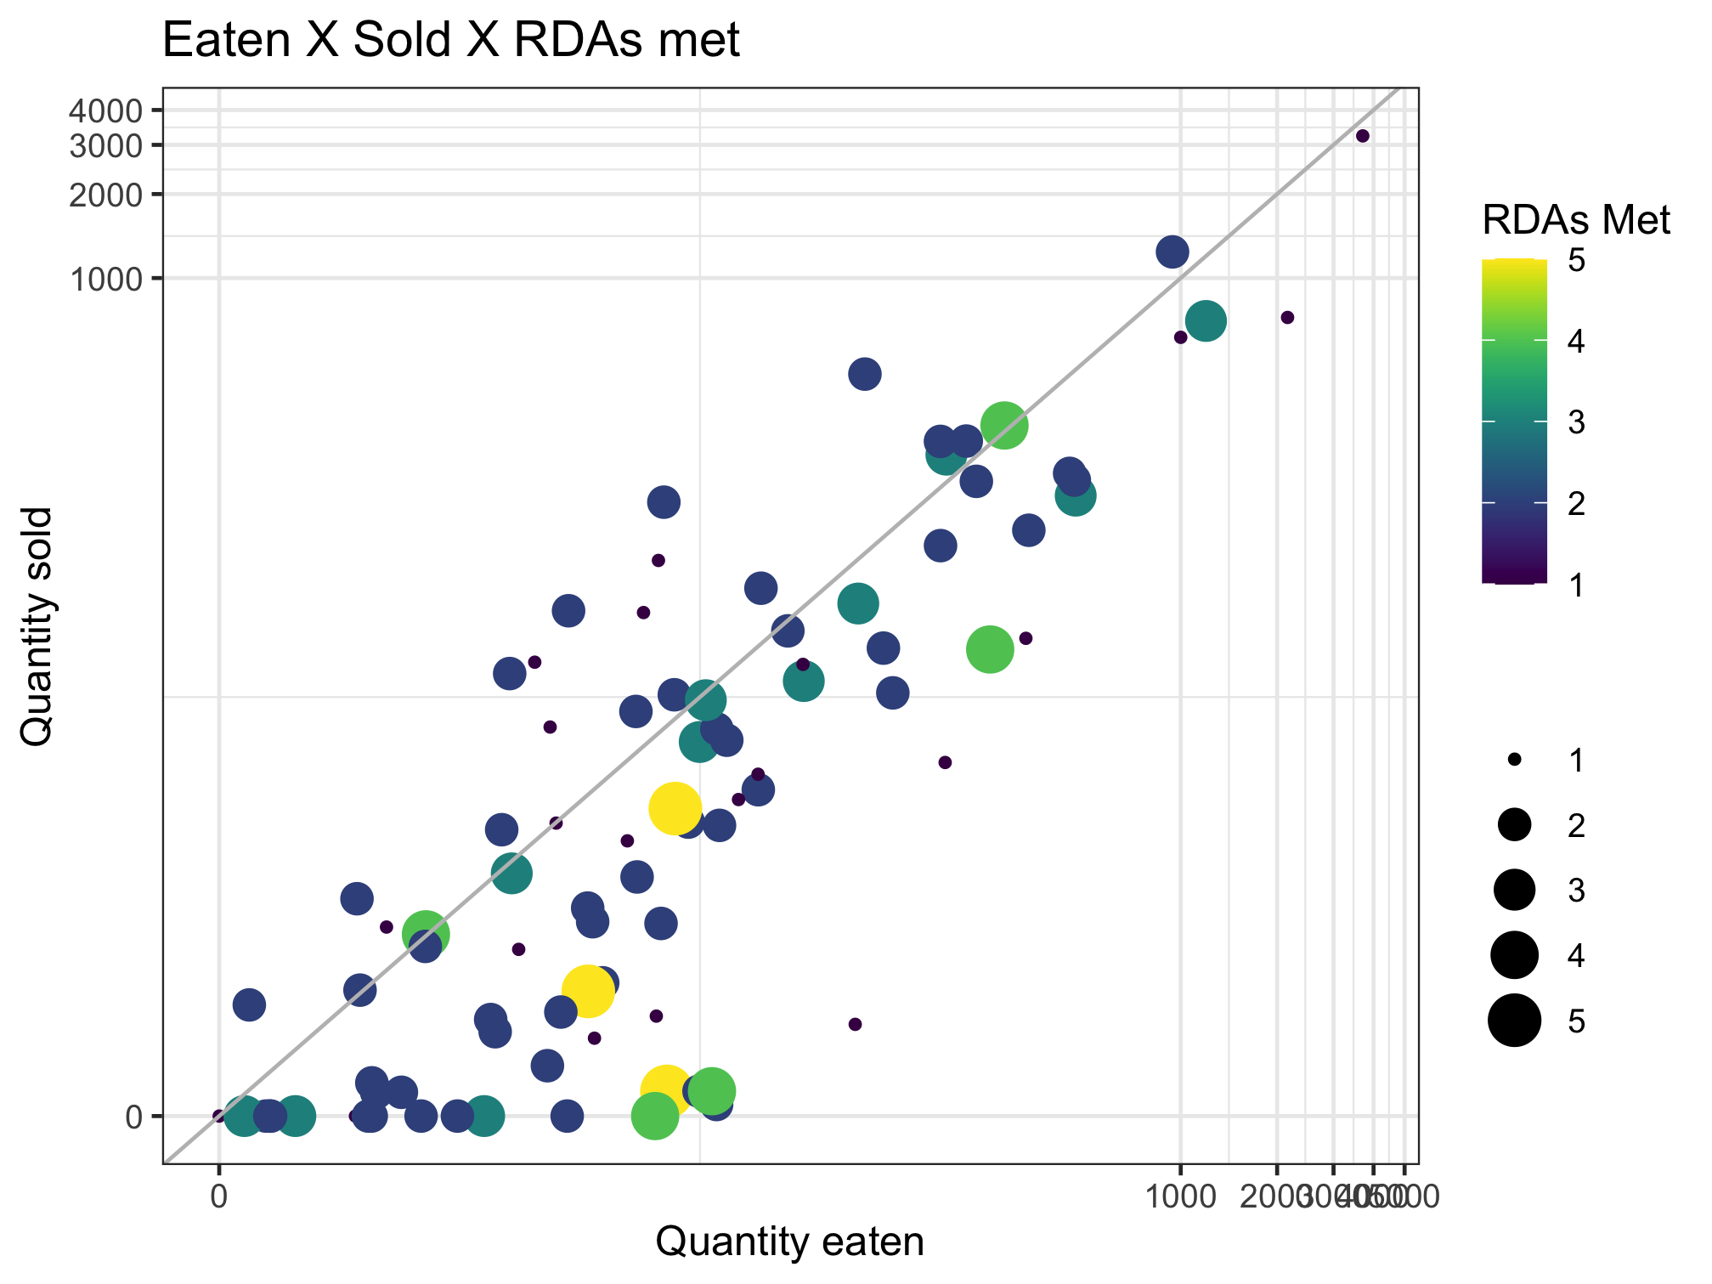
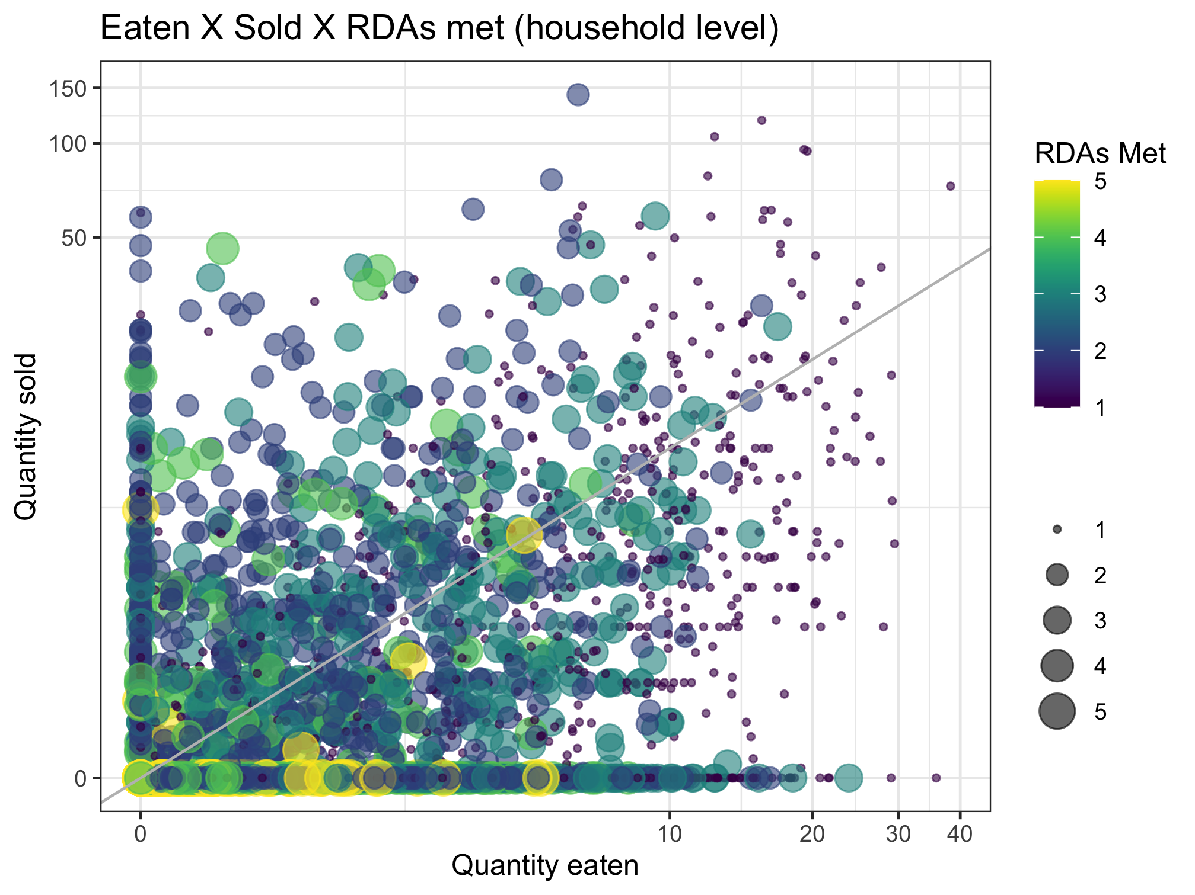
Nutrient diversity in the food system
Sold diversity
System diversity
Catch diversity
Consumption diversity
Nutrient diversity in household diets

Slide 9
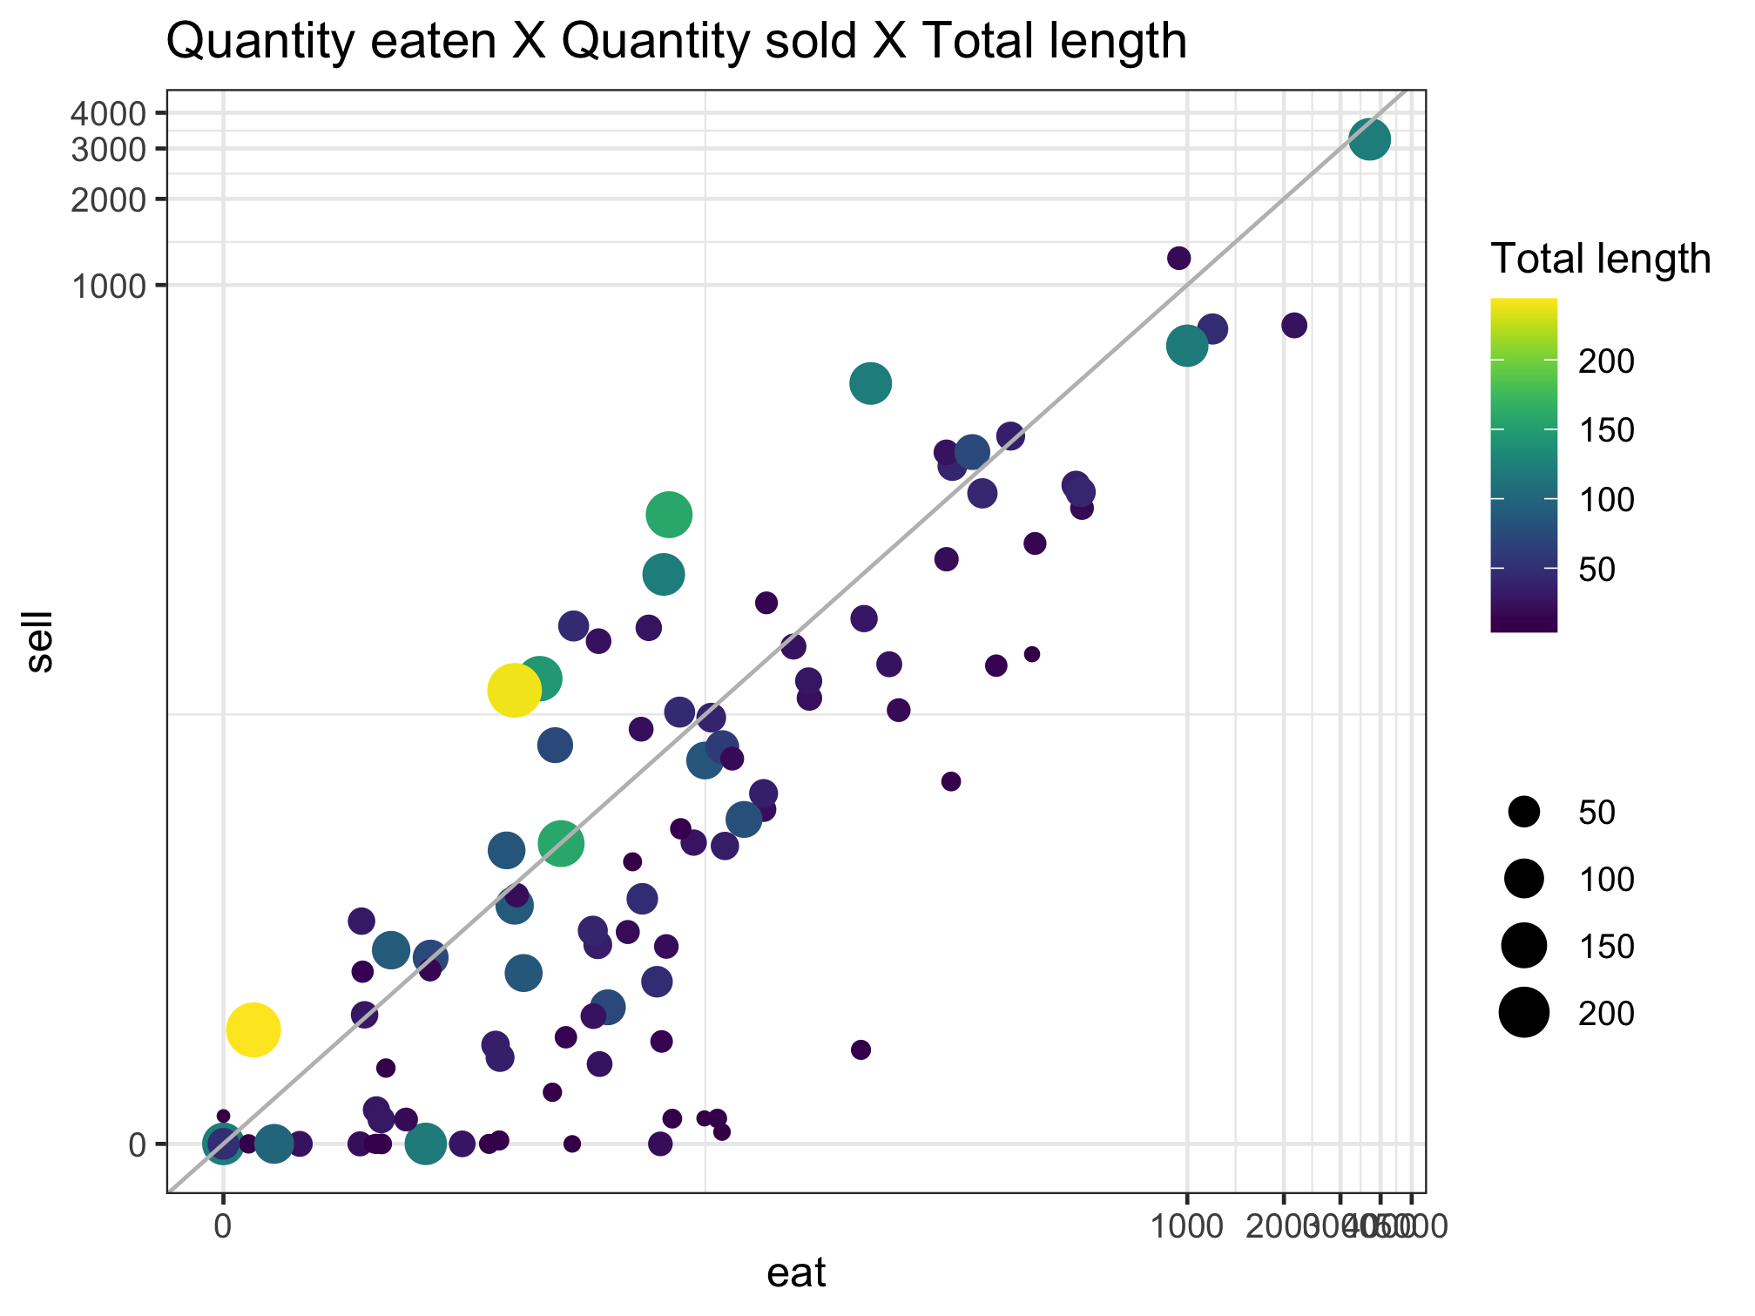
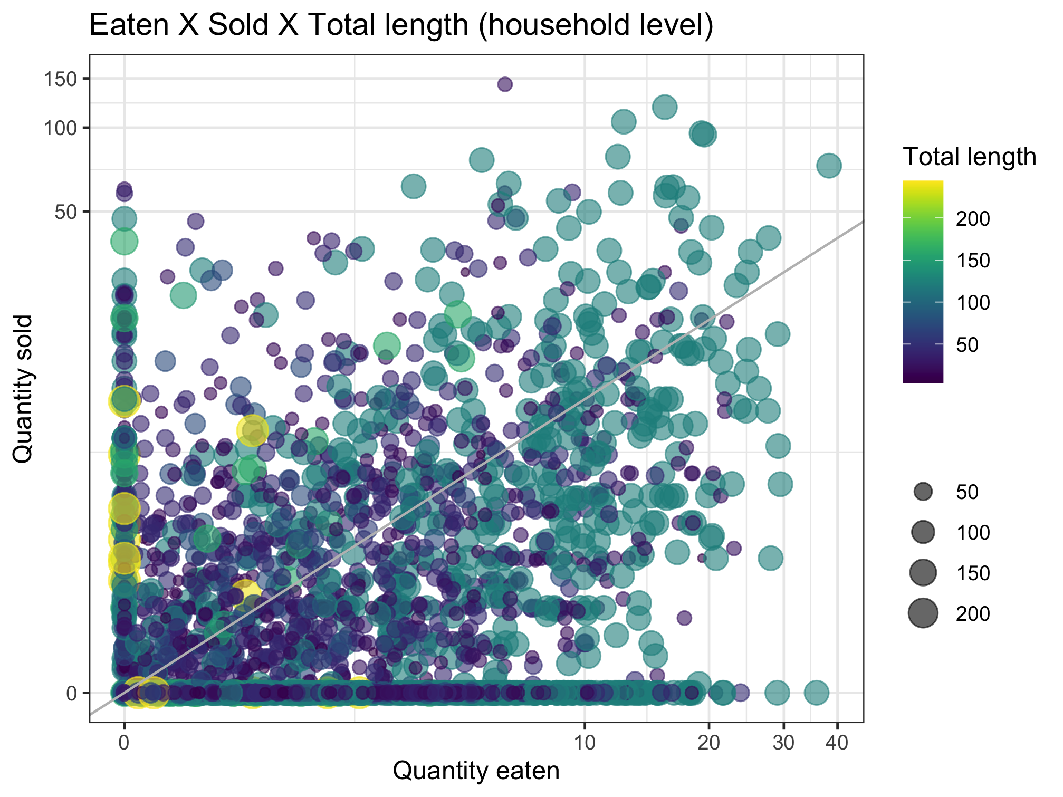
Nutrient diversity in the food system
Sold diversity
System diversity
Catch diversity
Consumption diversity
Nutrient diversity in household diets

Slide 10
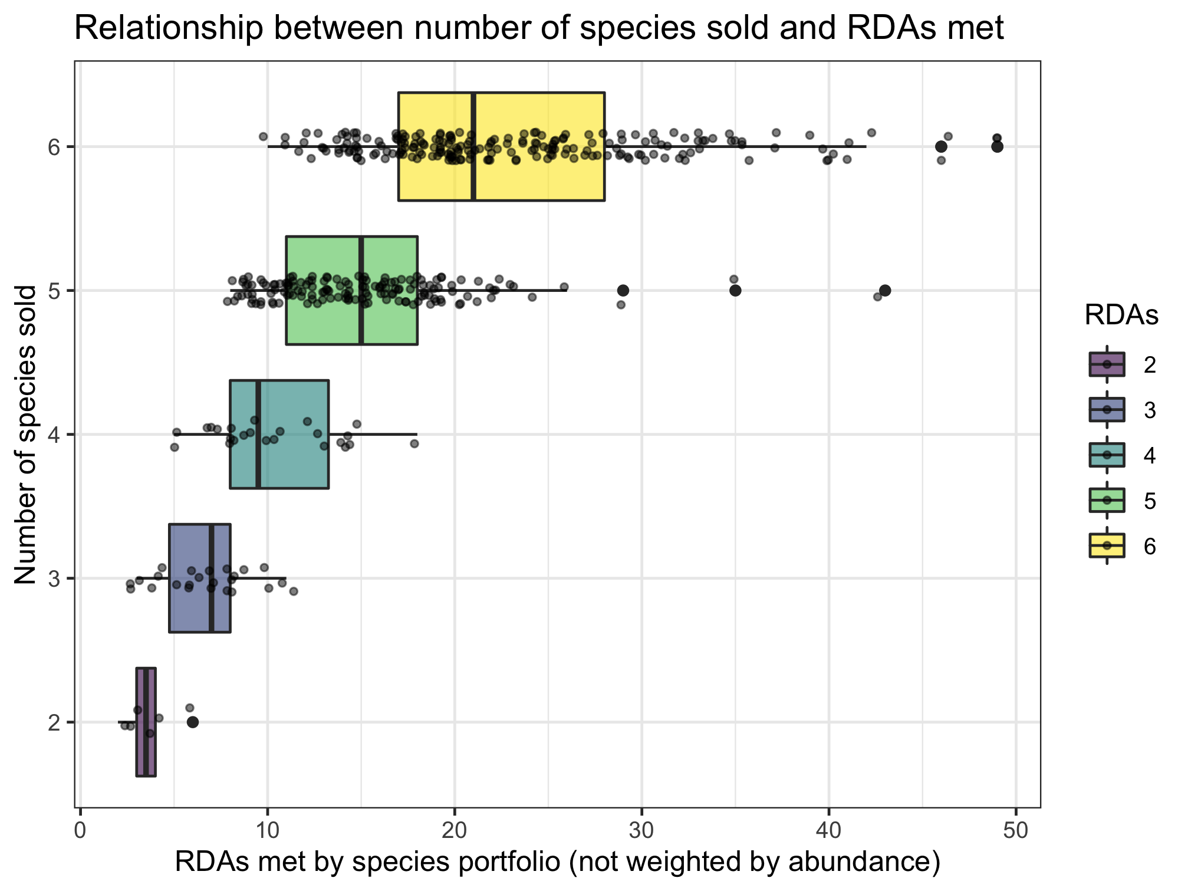
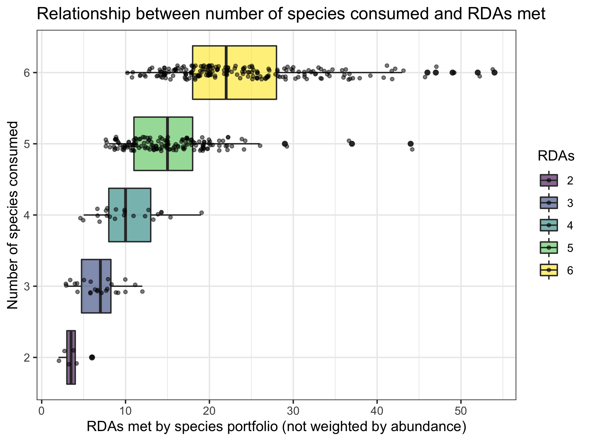
Nutrient diversity in the food system
Sold diversity
System diversity
Catch diversity
Consumption diversity
Nutrient diversity in household diets
Slopes if RDAs treated as continuous:
0.701 (sold)
0.697 (consumed)

